Slide 1
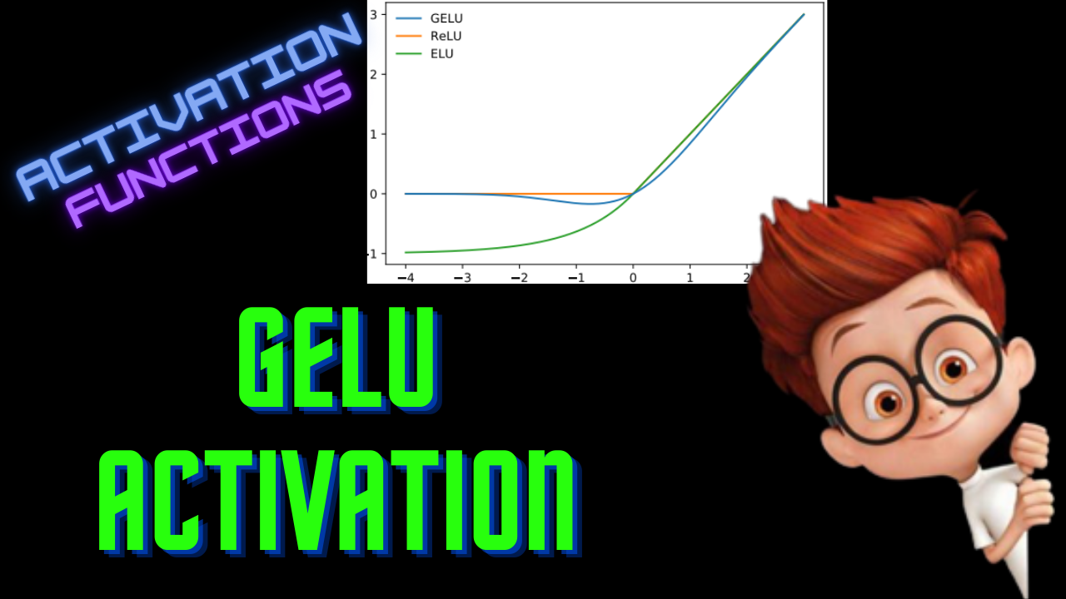

Slide 2
Motivation
Combine ReLU & Dropout
ReLU - multiplies the input by 1 or 0
Dropout - Randomly drops neurons

Slide 3
Gaussian Error Linear Unit
Weighted sum - x
g(x) = GeLU(x) = x * m
m = Cumulative Distribution Function(Normal Distribution)

Slide 4
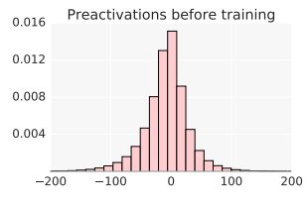


Intuition
Input:
ResNet-50

Slide 5
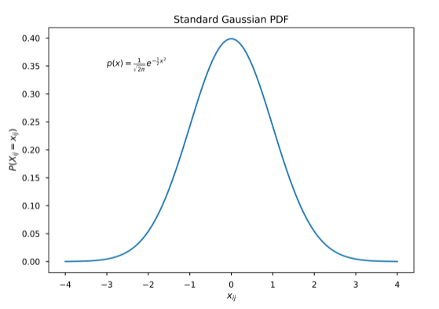



Intuition

Slide 6

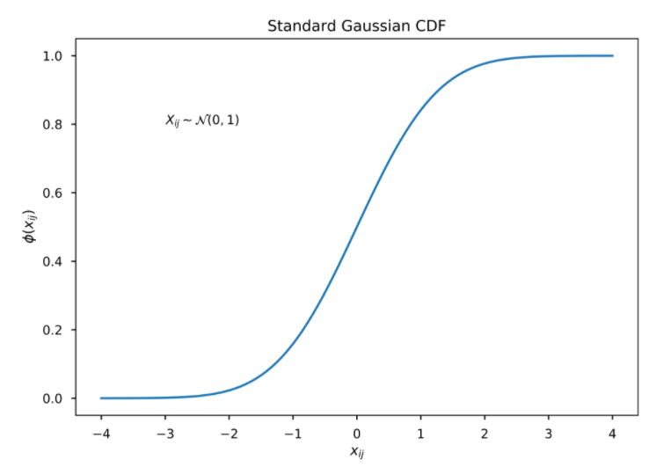

Intuition
0 for negative inputs
X for positive inputs
zero-to-Identity Mapping

Slide 7
Intuition

Slide 8

Intuition

Slide 9



Intuition
Gauss Error Function - erf(x)

Slide 10



GeLU Activation

Slide 11
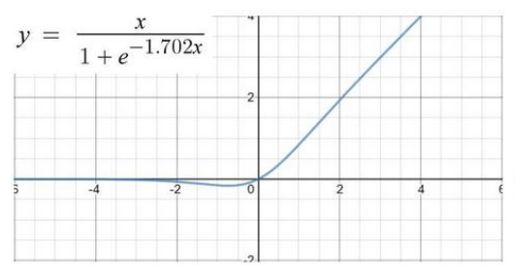
Sigmoid Approximation

Slide 12
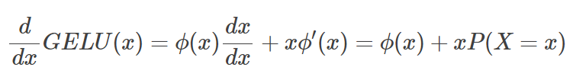
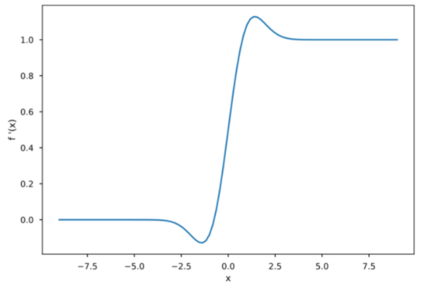
Derivative
P(X=x) is value of PDF at x

Slide 13
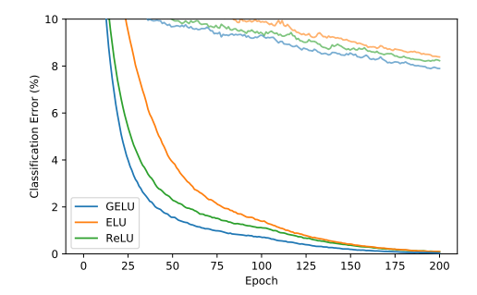
Experiments
CIFAR-10

Slide 14
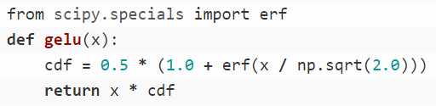
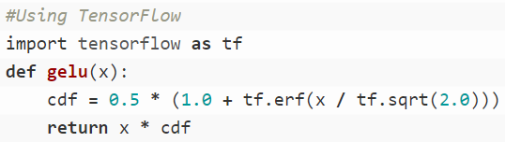
Python Implementation

Slide 15
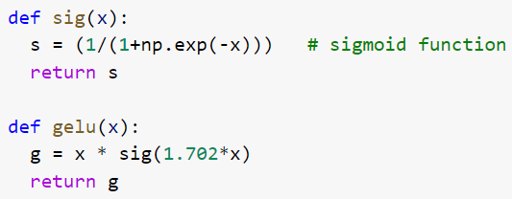
Python Implementation

